Slide 1
Lab 1B - Tone Generator

Slide 2
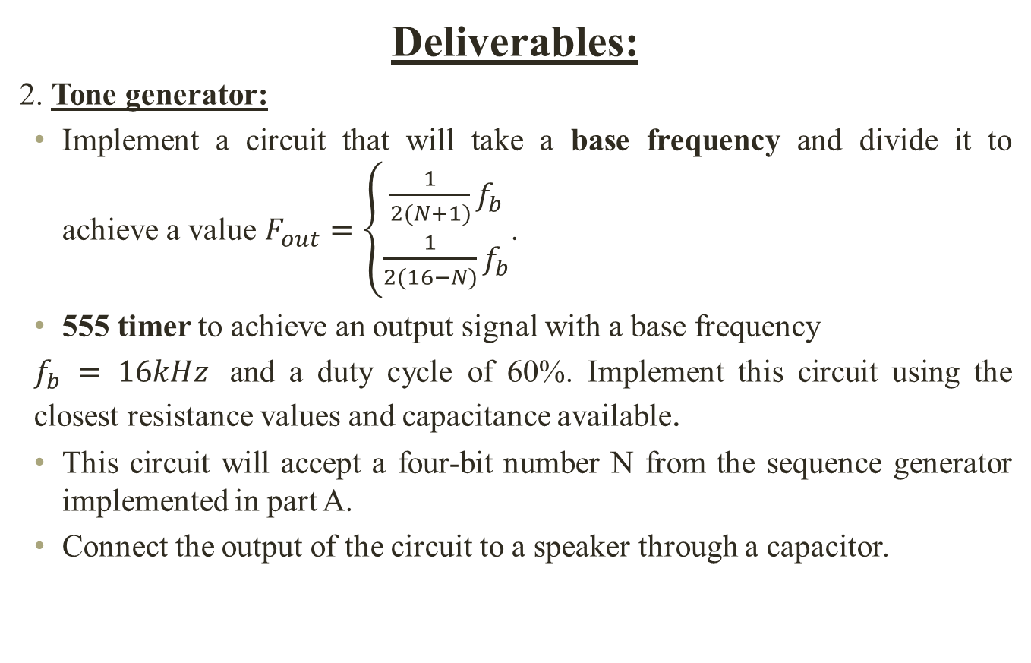
Implementation LAB 1
Deliverables:
2. Tone generator:
Implement a circuit that will take a base frequency and divide it to achieve a value $F_{out}=\left\{\begin{aligned}\frac{1}{2(N+1)}f_{b} \\ \frac{1}{2(16−N)}f_{b}\end{aligned}\right.$.
555 timer to achieve an output signal with a base frequency
$f_{b} = 16kHz$ and a duty cycle of 60%. Implement this circuit using the closest resistance values and capacitance available.
This circuit will accept a four-bit number N from the sequence generator implemented in part A.
Connect the output of the circuit to a speaker through a capacitor.

Slide 3
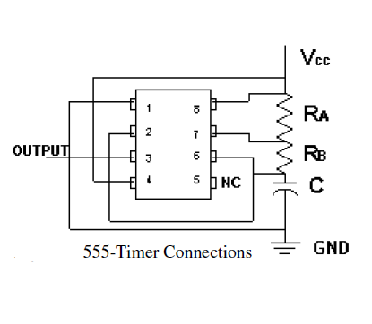
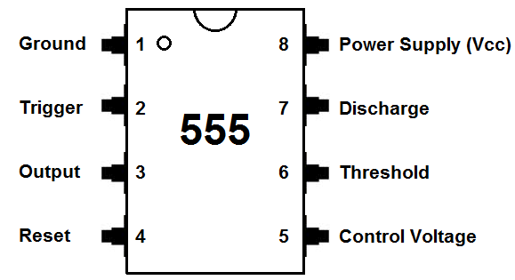




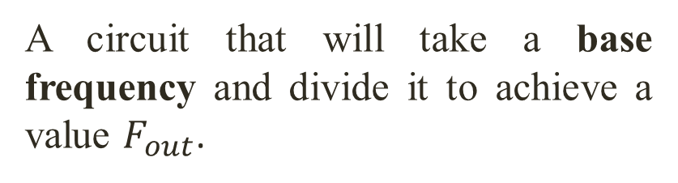
8:1
Mux
Toggle
Switch
Frequency Division
D FF
$$\frac{f_{1}}{2}$$
7476
74169
1CK
1PR
1CLR
1J
VCC
2CK
2PR
2CLR
1K
1Q
1Q’
GND
2K
2Q
2Q’
2J
U/D
Clk
A
B
C
D
EN T
GND
Vcc
ROC
QA
QB
QC
QD
EN P
Load
$$f_{1}$$
A circuit that will take a base frequency and divide it to achieve a value $F_{out}$.
8:1
Mux
D FF
8:1
Mux
D FF
Sequence Generator
Implemented in part A
ENT, ENP => Gnd
D FF
$$f_{b}$$
+
8:1
Mux
$$47μF$$
-
Base Frequency Generator
With 555 timer
Clock
(Pulse Switch)
Tone Generation

Slide 4
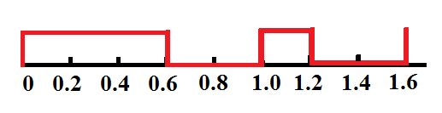






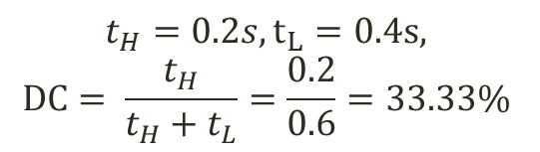
Duty Cycle
A cycle is a period for which a signal to complete an on-and-off time.
A duty cycle is a fraction of a cycle in which the signal is active or on. $DC= \frac{t_{H}}{t_{H}+t_{L}}×100\%.$
60% Duty cycle means the signal is on for 60% of the cycle.
For example. 1 cycle = 1 second, the signal is on for 0.6 second.
Signal Frequency:
no of cycle per second.
1 Cycle
1 Cycle
1 Cycle
$t_{high}$
$t_{low}$
$t_{low}$
$t_{low}$
$t_{high}$
$t_{high}$
time
60% DC
$$t_{H}=0.2s, t_{L}=0.4s,$$
$$DC= \frac{t_{H}}{t_{H}+t_{L}}=\frac{0.2}{0.6}=33.33\%$$
Time,s

Slide 5
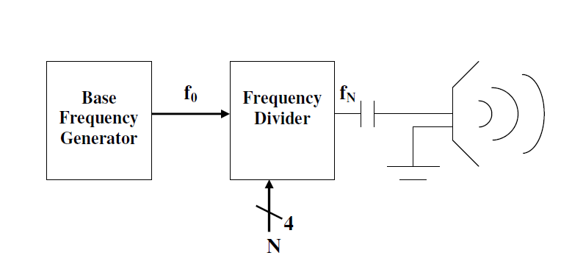
Tone Generator
Frequency Generator:
555 Timer:
can generate the frequency from 1 to 500 kHz.
Monostable, Bistable and Astable modes.
In monostable mode, the 555 timer outputs a single pulse of current for a certain length of time. This is sometimes referred to as a one-shot pulse.
In Bistable mode, 555 acts as a flip flop circuits.
In Astable mode, the signal is alternating between two states (on and off) for predefined period.
Notes:
555 can generate frequency from 1 to 500 KHz.
It has monostable, bistable and astable modes.

Slide 6
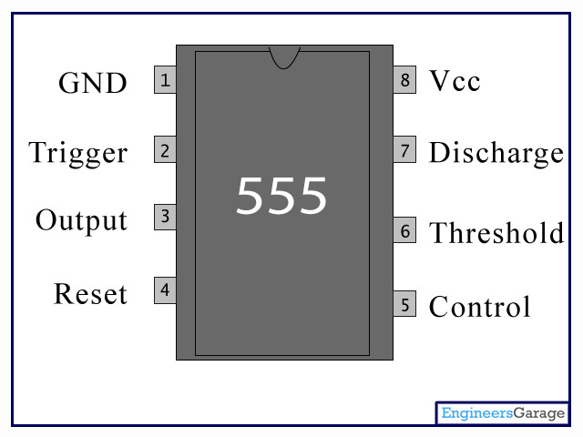






Tone Generator(Contd.)
In astable mode, the 555 needs to generate 16kHz, 60% DC signal. Connect as shown
in Figure. The output signal will have a high time and a low time:
The period of this signal is:
$$T= \frac{1}{frequency}$$
Use$C=10nF.$
Find RA and RB.

Slide 7
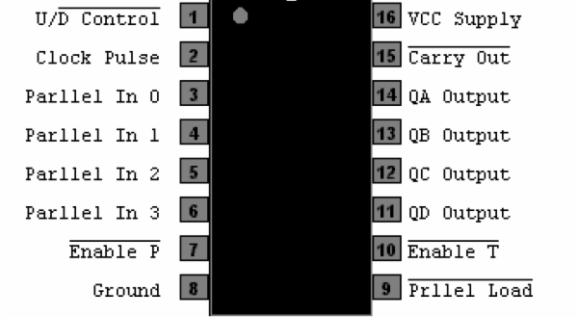
74LS169 Binary Counter
U/D
ROC
ENP
ENT
Load
EN P, EN T => GND
Activate the counter.
Load = 0
Q_{D}Q_{C}Q_{B}Q_{A} = IN₃IN₂IN₁IN₀
Load = 1
perform counting
Check U/D and peform counting.
U/D = 1
Up counting. (0->1->…..->15->0->1…..)
U/D = 0
Down counting. (15->14->…..->0->15->14…..)
Becomes zero when the counter reaches to the max or lowest counting stage .
ROC = 0 when up counting and Q_{D}Q_{C}Q_{B}Q_{A} = 15.
ROC = 0 when down counting and Q_{D}Q_{C}Q_{B}Q_{A} = 0.
ROC

Slide 8




74169 Waveform for Up Counting
1 2 3 4
1 2 3 4
1 2 3 4
1 2 3 4
Clk
H
H
H
H
H
H
H
H
H
H
H
H
H
H
U/$\overline{D}$
H
L
L
L
H
H
L
H
H
H
H
H
H
H
$$\overline{Load}$$
H
DCBA
12 12 12 12 12 12 12 12 12 12 12 12 12 12 12 12 12 12 12 12 12 12
12
QD-QA
x
12
13
14
15
12
13
14
15
12
13
14
15
12
13
14
15
12
13
14
15
$$\overline{ROC}$$
1
1
1
1
1
1
Compare the no. of Cycle between Clock and ROC.
U/D
CLK
In0
In1
In2
In3
ENP
GND
VCC
ROC
QA
QB
QC
QD
ENT
Load
DCBA= 1100
$\overline{ROC} freq= \frac{1}{4} Clk freq$ for $DCBA =1100.$
0
0

Slide 9
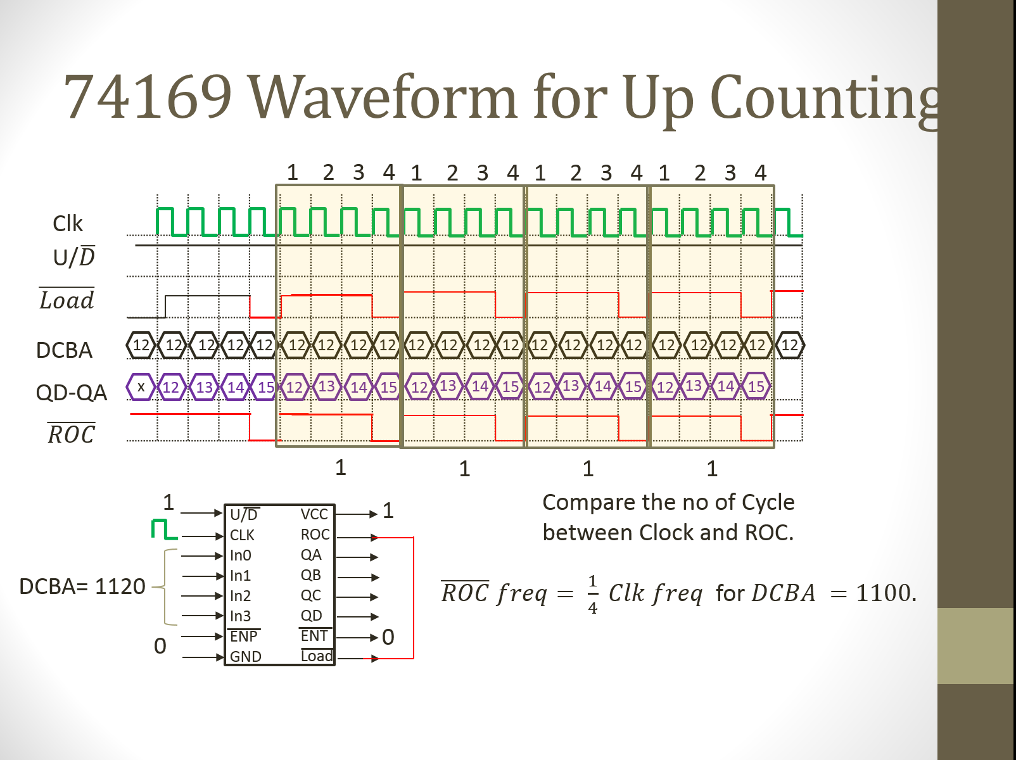
1100

Slide 10
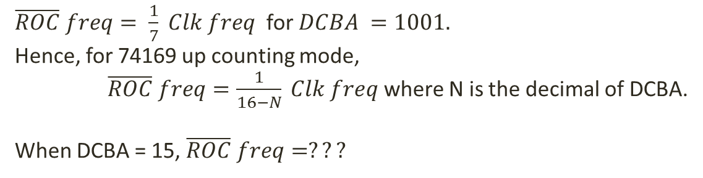
74169 Waveform for Up Counting
Clk freq:
1 2 3 4 5 6 7
Clk freq:
1 2 3 4 5 6 7
Clk freq:
1 2 3 4 5 6 7
Clk
U/$\overline{D}$
$$\overline{Load}$$
DCBA
9 9 9 9 9 9 9 9 9 9 9 9 9 9 9 9 9 9 9 9 9 9
12
QD-QA
X 9 10 11 12 13 14 15 9 10 11 12 13 14 15 9 10 11 12 13 14 15
12
$$\overline{ROC}$$
1
ROC freq:
1
ROC freq:
1
ROC freq:
$\overline{ROC} freq= \frac{1}{7} Clk freq$ for $DCBA =1001.$
Hence, for 74169 up counting mode,
$\overline{ROC} freq=\frac{1}{16−N} Clk freq$ where N is the decimal of DCBA.
When DCBA = 15, $\overline{ROC} freq=???$

Slide 11
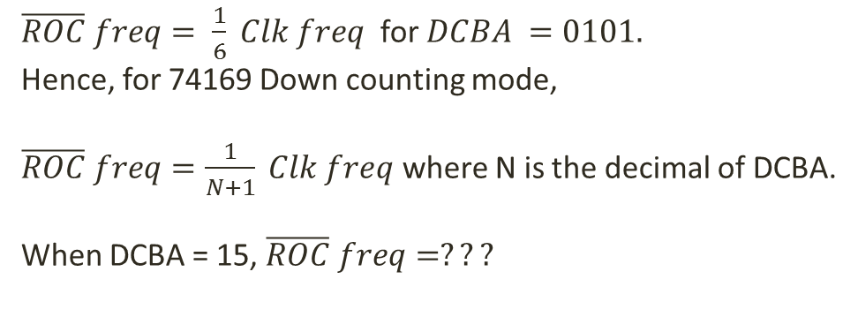
74169 Waveform for Down Counting
Clk freq:
1 2 3 4 5 6
Clk freq:
1 2 3 4 5 6
Clk freq:
1 2 3 4 5 6
Clk
U/$\overline{D}$
$$\overline{Load}$$
DCBA
5 5 5 5 5 5 5 5 5 5 5 5 5 5 5 5 5 5 5 5 5 5
12
QD-QA
X 5 4 3 2 1 0
5 4 3 2 1 0
5 4 3 2 1 0
5 4 3
12
$$\overline{ROC}$$
1
ROC freq:
1
ROC freq:
1
ROC freq:
$\overline{ROC} freq= \frac{1}{6} Clk freq$ for $DCBA =0101.$
Hence, for 74169 Down counting mode,
$\overline{ROC} freq=\frac{1}{N+1} Clk freq$ where N is the decimal of DCBA.
When DCBA = 15, $\overline{ROC} freq=???$

Slide 12
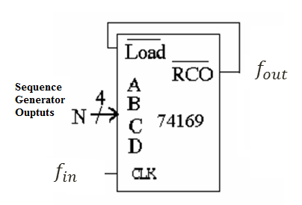
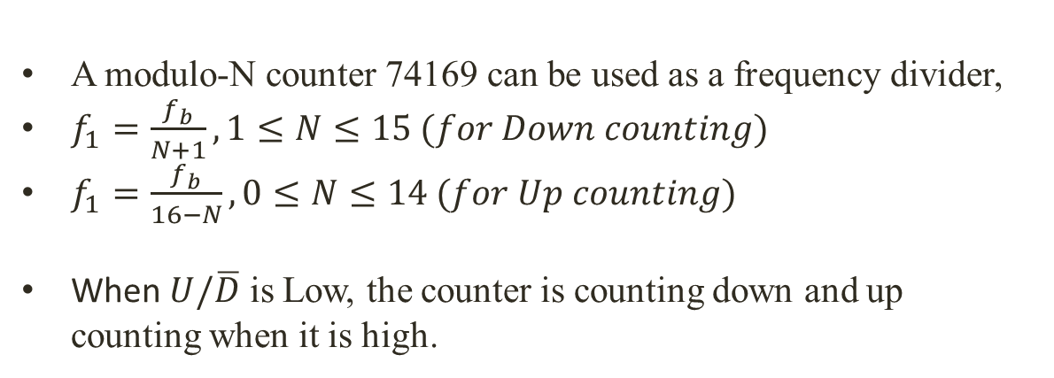


Frequency Division (Modulo N Counter)
$$f_{1}$$
$$f_{b}$$
A modulo-N counter 74169 can be used as a frequency divider,
$f_{1}=\frac{f_{b}}{N+1}, 1≤N≤15 (for Down counting)$
$f_{1}=\frac{f_{b}}{16−N}, 0≤N≤14 (for Up counting)$
When $U/\overline{D}$ is Low, the counter is counting down and up counting when it is high.

Slide 13
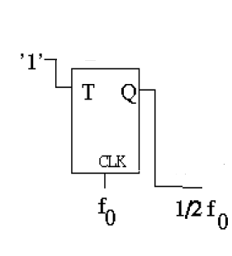
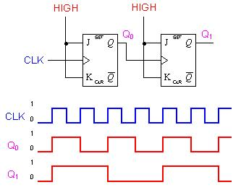
Frequency Division (T-FF)
T | Q
0 | Q
1 | Q
Correct the output waveform duty cycle to 50% by connecting with T-FF.
By Using a T flip flop we can divide the frequency by 2.
The T flip flop should be designed using a JK (7476) Flip Flop. (FF Conversion)

Slide 14
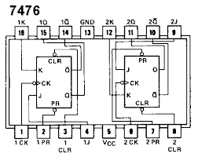
Convert J-K FF to T FF
Set J and K to Vcc
Set Vcc to PR and CLR
Flip Flop enters TOGGLE mode

Slide 15

8:1
Mux
Toggle
Switch
Frequency Division
D FF
$$\frac{f_{1}}{2}$$
7476
74169
1CK
1PR
1CLR
1J
VCC
2CK
2PR
2CLR
1K
1Q
1Q’
GND
2K
2Q
2Q’
2J
U/D
Clk
A
B
C
D
EN T
GND
Vcc
ROC
QA
QB
QC
QD
EN P
Load
$$f_{1}$$
8:1
Mux
D FF
8:1
Mux
D FF
ENT, ENP => Gnd
8:1
Mux
D FF
$$f_{b}$$
+
$$47μF$$
-
Clock
(Pulse Switch)
Tone Generation
74169
U/D -> toggle switch
ENT,ENP -> GND.
7476
1J,1K,1PR, 1CLR - > Vcc
Sequence Generator
Base Frequency Generator

Slide 16
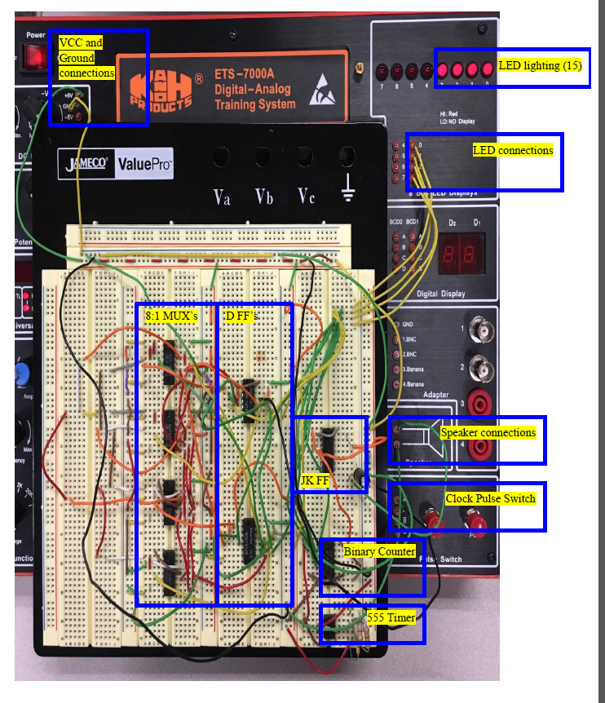
SAMPLE CIRCUIT PHOTO

Slide 17
Report
Follow the sample report for details.
Objective (10 points)
Equipment (10 points)
Description (10 points)
Design Synthesis (20 points)
Kmaps and Boolean Expressions
Complete logic Diagram (20 points)
Complete Circuit block diagram
Results and Simulation (10 points)
Pic of your implementation
ALL photos/simulations should be accompanied by a clear explanation.
Conclusion (20 points).

